Slide 1

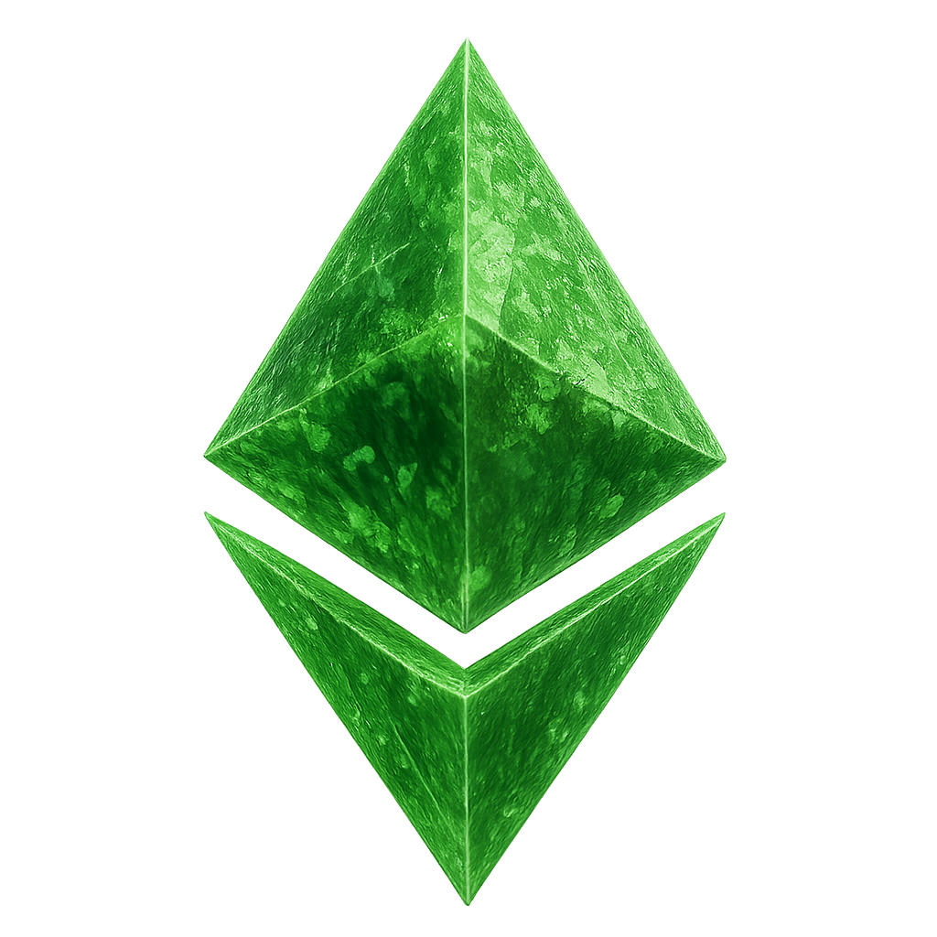


Oz
OzoneX
Oz
OzoneX
x
EN
x
EN
OZONE Token Staked
Staked Duration
Please connect wallet
12,375.00
05D:20H:23M:15S
Connect Wallet
USDT Earned
Claim
206.25 USDT
Min. 618.75 USDT to Claim
OzoneX Labs © 2025 | All Rights Reserved
Version 1.0.0
Max Profit
206.25 / 37,125 USDT

Slide 2
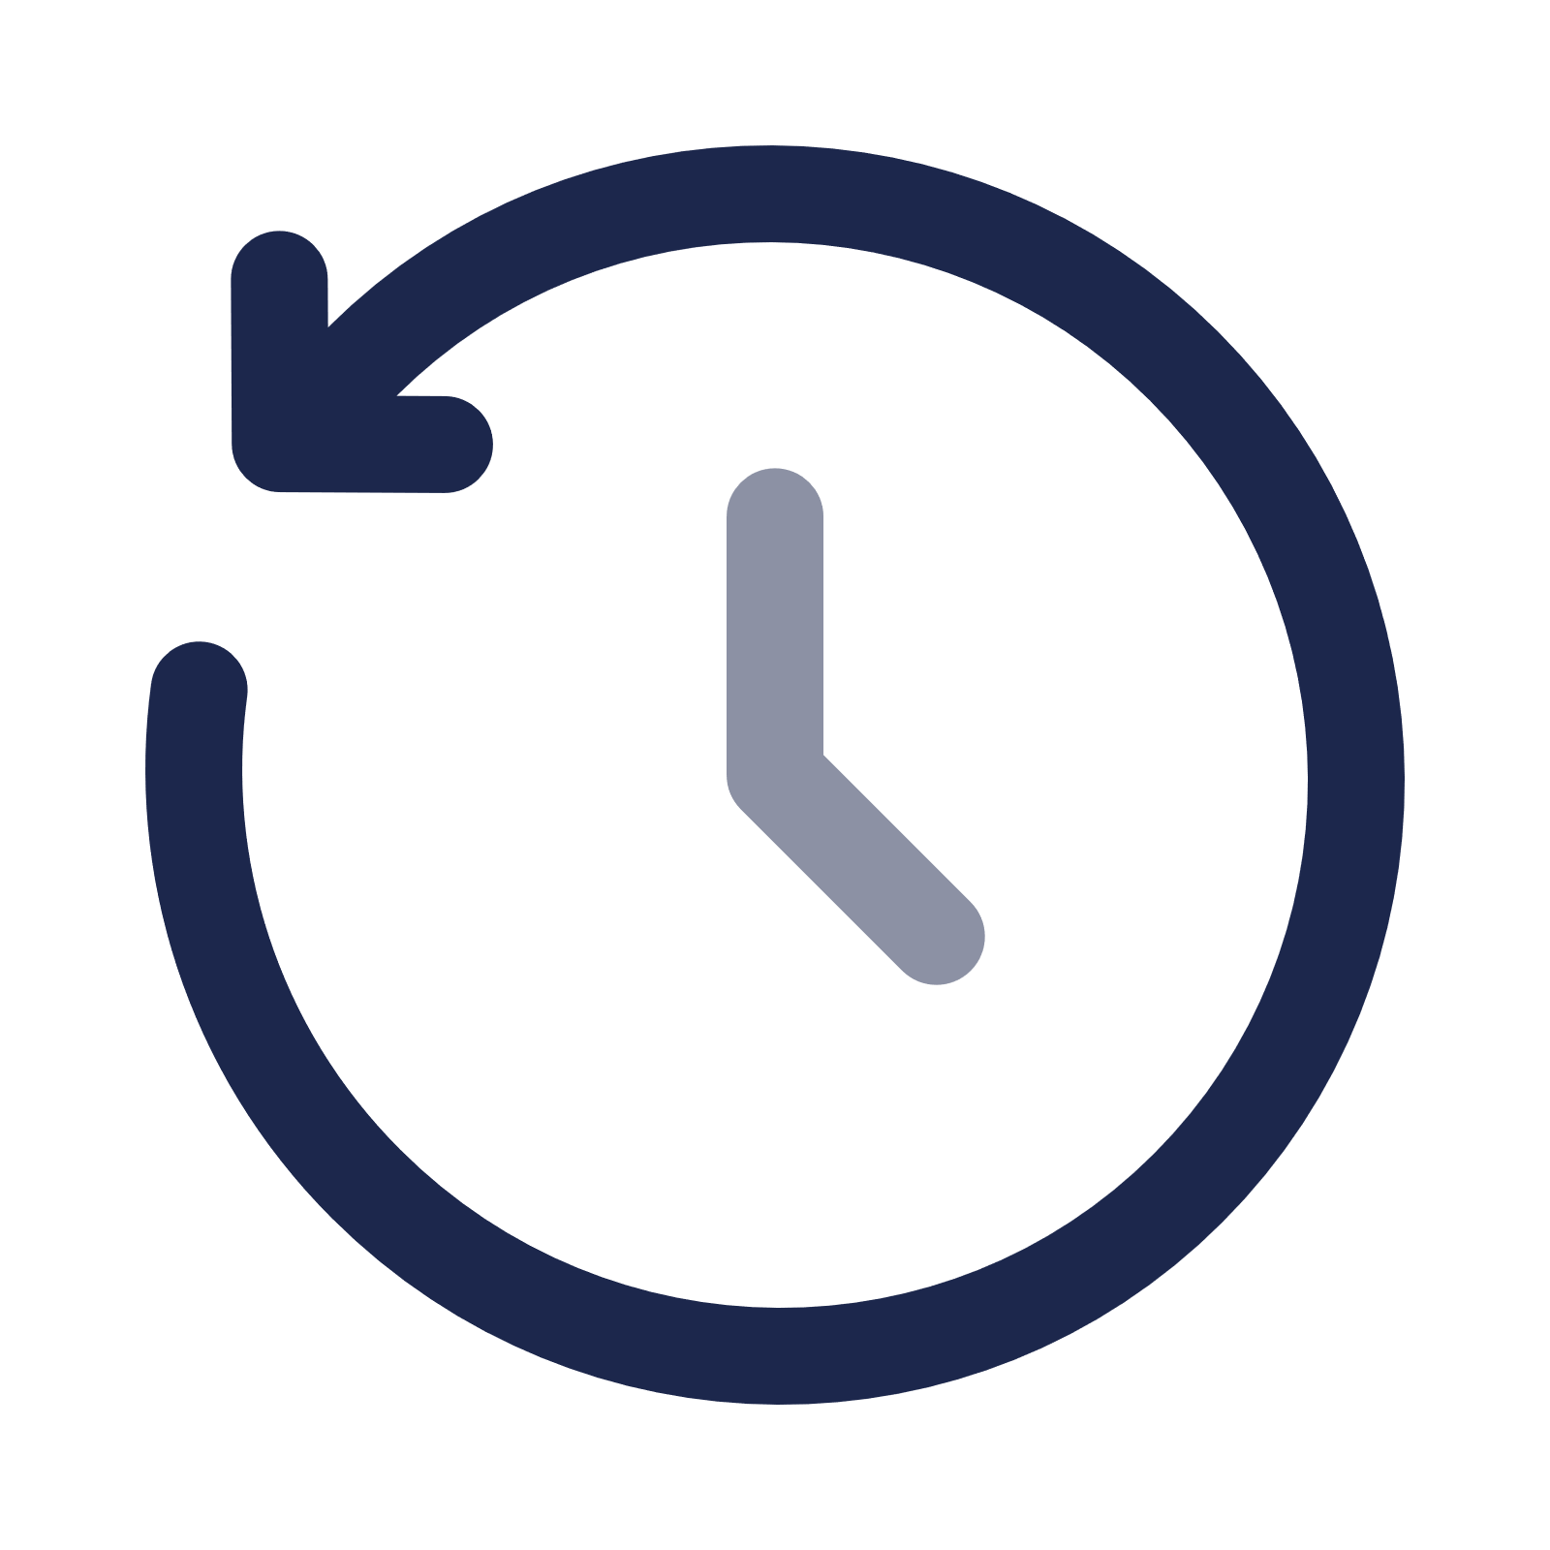







Oz
OzoneX
Oz
OzoneX
x
EN
x
EN
1,000,000,000
Purchase OZONE Token
History
OZONE Token Price $0.80
Balance
10,000.00 USDT
PRESALE
STAGE 1
MAX
2,000,000 Tokens
Purchase
Amount
12,500.00 Token
MAX
Total Purchase
10,000.00 USDT
Tax (1%)
100.00 USDT
Amount to Receive
12,375.00 OZONE
OZONE Token Total Supply
1,000,000,000
Purchase/Swap
OZONE Token Price $0.80
Staking Pool
Staking Pool
Home
Swap
Staking
Assets
Home
Swap
Staking
Assets

Slide 3
Oz
OzoneX
Oz
OzoneX
x
EN
x
EN
OZONE Staking
History
OZONE Staking
History
Stake Now
Stake Now
Min Yield 6% per mo.
Max Yield 10% per mo.
Min Yield 6% per mo.
Max Yield 10% per mo.
Ozone Token Balance
Ozone Token Balance
12,375.00
Buy/Swap
0.00
Buy/Swap
Staking Summary
Staking Summary
Token Staked
USDT Earned
Token Staked
USDT Earned
0.00
0.00
12,375.00
206.25
Staking History
Staking History
Start Date -
Estimated Last Date -
Start Date 02 Sept 2025
Estimated Last Date 19 Feb 2028
Staking Pool
Staking Pool
Home
Swap
Staking
Assets
Home
Swap
Staking
Assets

Slide 4

Oz
OzoneX
Oz
OzoneX
x
EN
x
EN
Staking Pool
SaproX - Pool A
STAKE
NOW
Min 5,001 Tokens
Max 10,000 Tokens
LimoX - Pool A
STAKE
NOW
Min 100 Tokens
Max 1,000 Tokens
APY 9% per month
APY 6% per month
SaproX - Pool B
STAKE
NOW
LimoX - Pool B
Min 10,001 Tokens
Max Unlimited
STAKE
NOW
Min 1,001 Tokens
Max 3,000 Tokens
APY 10% per month
APY 7% per month
LimoX - Pool C
STAKE
NOW
Min 3,001 Tokens
Max 5,000 Tokens
APY 8% per month
Home
Swap
Staking
Assets

Slide 5





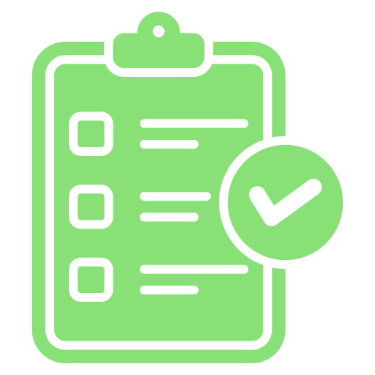
Oz
OzoneX
x
EN
Menu
X
SaproX - Pool B
D
0x9a30….6044
ID #9900231
BNB Network
Max Quota
208,000 / 10,000,000 Token
Home
Referral Program
Balance
12,375.00 Token
Community Summary
Setting Language
Amount
Stake
>
12,375.00 Token
Referral Program
MAX
Maximize your potential with
Friends and Community.
Monthly Yield
10%
Monthly USDT Earning
1,237.50 USDT
>
Account Summary
Daily USDT Earning
41.25 USDT
Check your Account Summary
everyday from here.
Stake Now
Home
Swap
Staking
Assets
Home
Swap
Staking
Assets

Slide 6
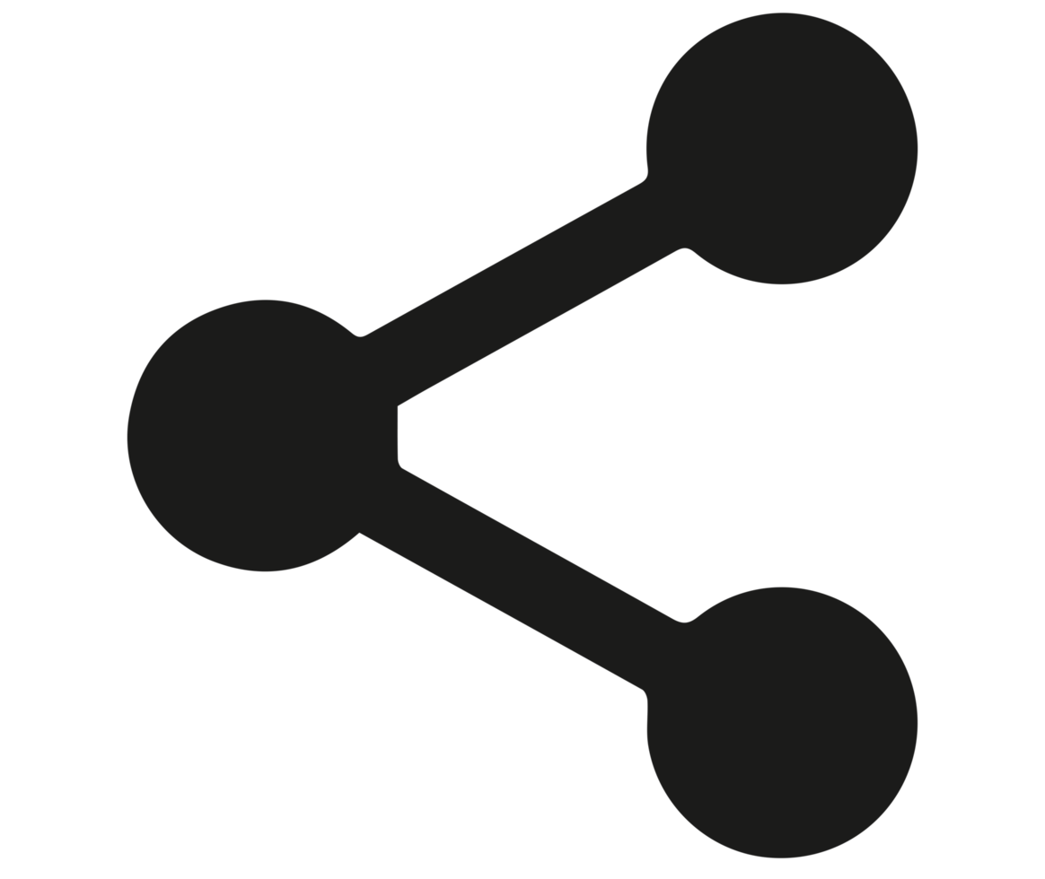
Oz
OzoneX
Oz
OzoneX
x
EN
x
EN
Referral Program
Sponsor Bonus
Sponsor Summary
Total Level 1 4
Total Level 2 0
Level 1 Total Staking
Yield
1,000,000.00
0.80%
Level 2 Total Staking
Grow Together with Your Community
Be more Prosperous and Successful
Yield
0.00
0.50%
Referral Code
ozx99021a
Monthly Token Earnings
8,000 Tokens
Daily Token Earnings
266 Tokens
Copy Link
Total Token Earned
233 Tokens
Max Token Earnings
37,125 Tokens
Home
Swap
Staking
Assets
Home
Swap
Staking
Assets

Slide 7
Oz
OzoneX
Oz
OzoneX
x
EN
x
EN
Sponsor Bonus
Sponsor Bonus
Sponsor Summary
Sponsor Summary
Total Level 1 4
Total Level 2 5
Total Level 1 4
Total Level 2 20
Level 1 Total Staking
Level 1 Total Staking
Yield
Yield
100,000.00
0.80%
1,000,000.00
0.80%
Level 2 Total Staking
Level 2 Total Staking
Yield
Yield
50,000.00
0.50%
850,000.00
0.50%
Monthly Token Earnings
1,050 Tokens
Monthly Token Earnings
12,250 Tokens
Daily Token Earnings
35 Tokens
Daily Token Earnings
408 Tokens
Total Token Earned
350 Tokens
Total Token Earned
MAX
37,125 Tokens
Max Token Earnings
37,125 Tokens
Max Token Earnings
37,125 Tokens
Home
Swap
Staking
Assets
Home
Swap
Staking
Assets

Slide 8
Oz
OzoneX
Oz
OzoneX
x
EN
x
EN
Community Summary
VIEW CLASS
Community Class
Monthly
Yield
B
Bronze Member
Min 50,000 Tokens Staked
0.10%
D
ID #9900231
Yield
0x9a30….6044
0.70%
S
Silver Member
Min 200,000 Tokens Staked
0.30%
Account Tokens Staked
12,375 Tokens
Gold Member
Min 500,000 Tokens Staked
Community Tokens Staked
1,000,000 Tokens
G
0.50%
Monthly Token Earnings
7,000 Tokens
Diamond Member
Min 1,000,000 Tokens Staked
Daily Token Earnings
233 Tokens
D
0.70%
Total Token Earned
233 Tokens
Max Token Earnings
37,125 Tokens
#9900231
+
#9900257
250,000 Tokens
+
#9900268
250,000 Tokens
+
#9900299
250,000 Tokens
+
#9900301
250,000 Tokens
Home
Swap
Staking
Assets
Home
Swap
Staking
Assets

Slide 9
Oz
OzoneX
Oz
OzoneX
x
EN
x
EN
Account Summary
Staking History
0x9a30….6044
ID #9900231
Start Date 02 Sept 2025
Estimated Last Date 19 Feb 2028
D
BNB Network
Staking Summary
USDT Earned
Account Value
206.25
$12,375.00
Claim
Token Staked
USDT Earned
Min. 618.75 USDT to Claim
12,375.00
206.25
Max Profit
206.25 / 37,125 USDT
Monthly USDT Earning
1,237.50 USDT
Daily USDT Earning
41.25 USDT
Home
Swap
Staking
Assets
Home
Swap
Staking
Assets

Slide 10
Oz
OzoneX
Oz
OzoneX
x
EN
x
EN
Total Assets
Deposit
History
233.00 USDT
Token
USDT
→
→
Network
Deposit
Withdraw
Transfer
History
BEP20
My Assets
Assets
Amount
Deposit Amount
Balance: 10,000.00 USDT
USDT
Tether
0.00
~ $0.00
Enter Amount Here
MAX
USDT
OZONE
RWA Token
233.00
~ $233.00
DEPOSIT
Home
Swap
Staking
Assets
Home
Swap
Staking
Assets

Slide 11
Oz
OzoneX
Oz
OzoneX
x
EN
x
EN
Withdraw
History
Transfer
History
Withdraw Amount
Balance: 1,000.00 USDT
Transfer Amount
Balance: 233 OZONE
Enter Amount Here
MAX
USDT
Enter Amount Here
MAX
OZONE
Network
MAX MONTHLY WITHDRAW: 1,237.50 OZONE
Receiving Address
BEP20
0x21aC7CaD6089906887f15229DDfbd6FD0c08
Bc66
Receiving Address
0x21aC7CaD6089906887f15229DDfbd6FD0c08
Bc66
Transfer Amount
233.00 OZONE
Handling Fee
10.00 OZONE
Total Transfer Amount
223.00 OZONE
Withdraw Amount
0.00 USDT
Handling Fee
1.00 USDT
TRANSFER
Total Withdraw Amount
0.00 USDT
WITHDRAW
Home
Swap
Staking
Assets
Home
Swap
Staking
Assets

Slide 12
Oz
OzoneX
Oz
OzoneX
x
EN
x
EN
History
Setting Language
Please select your default language.
English
简体中文
日本語
한국어
Tiếng Việt
Bahasa Indonesia
Deposit
10,000 USDT
02-09-2025 - 4:05PM
Success
Swap
12,375 OZONE
02-09-2025 - 6:25PM
Success
Staking
12,375 OZONE
02-09-2025 - 6:55PM
Success
Transfer
233 OZONE
CONFIRM
03-09-2025 - 8:51AM
Pending
Home
Swap
Staking
Assets
Home
Swap
Staking
Assets

Slide 13
Oz
OzoneX
Oz
OzoneX
x
EN
x
EN
Home
Swap
Staking
Assets
Home
Swap
Staking
Assets

